Slide 1
University Students Complaint Prioritization using NLP

Slide 2

Problem Statement
The project aims to create an automated complaint prioritization system for universities using NLP techniques.
This system will analyze and classify complaints based on severity and urgency, improving resource allocation and student satisfaction.

Slide 3
Dataset
Called “Voice Heard”
7 features and 1006 rows
The features are
Genre
Reports
Age
GPA
Year
Count
Gender
‘Reports’ feature has the complaints from university students
’Genre’ has the labels

Slide 4
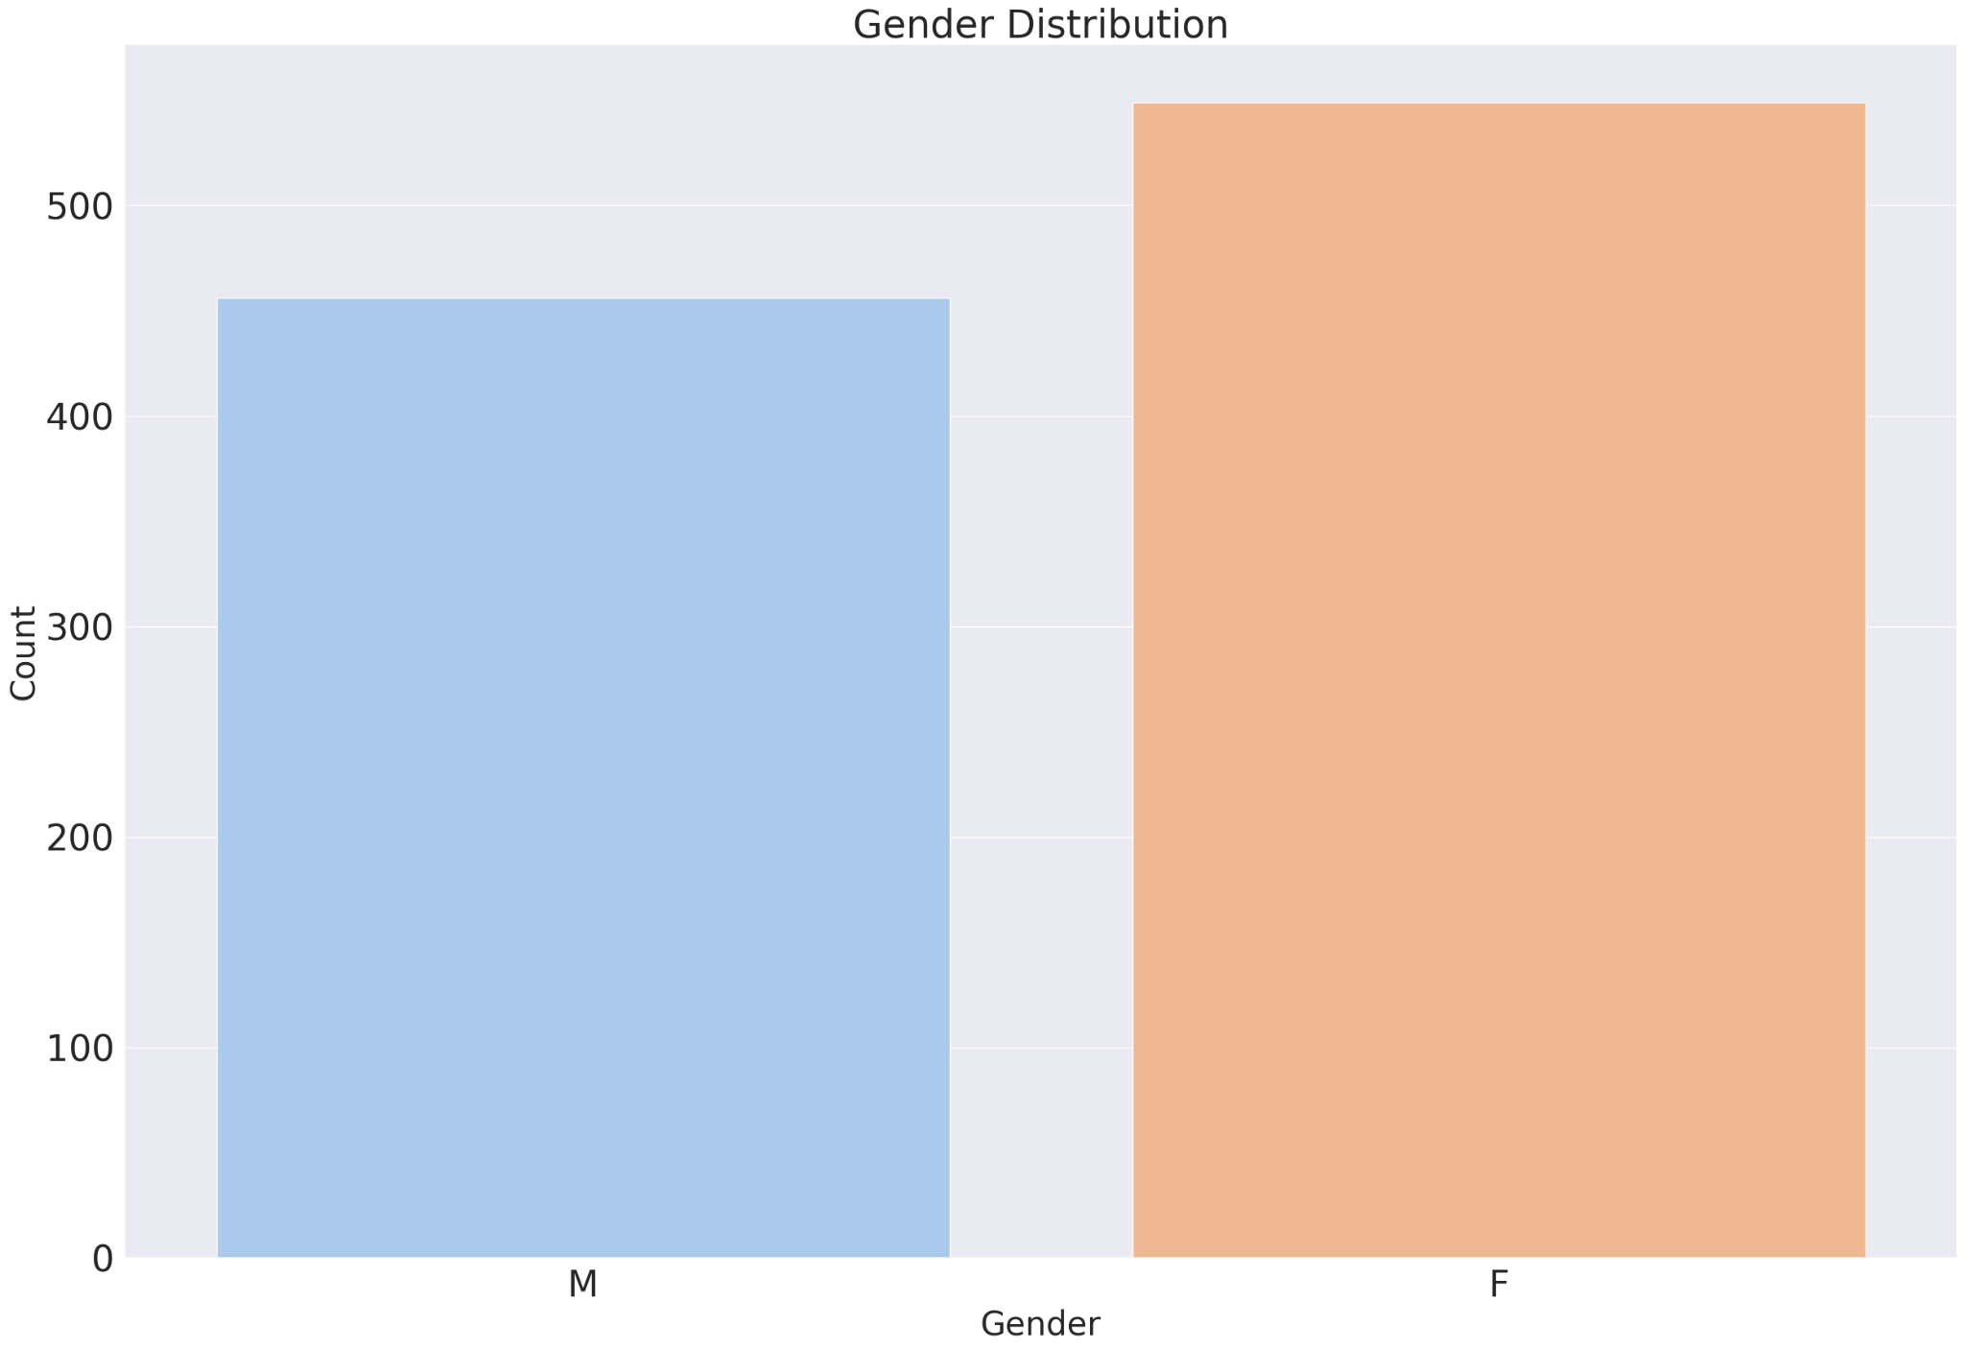
Exploratory Data Analysis
Countplot of Gender
It is visible that females raised more complaints than males

Slide 5
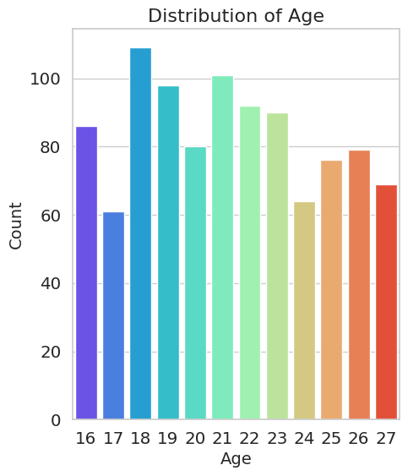
Exploratory Data Analysis
Insights from countplot
Students who are of age 18 made more complaints among others

Slide 6
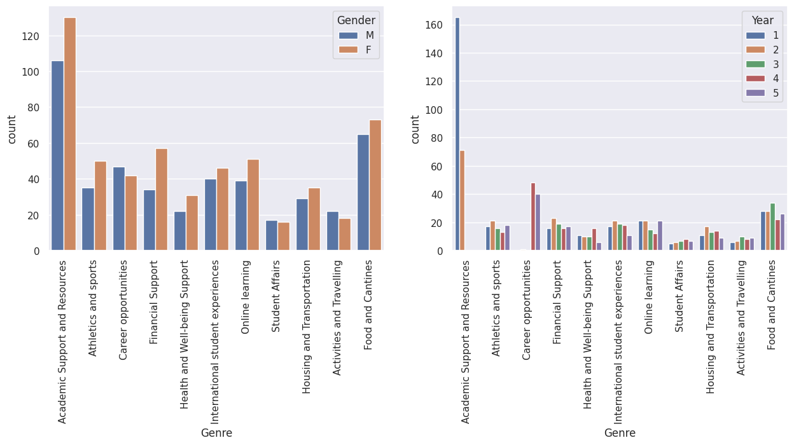
Group by method of Genre with Gender and year
As per first graph, it is visible that females raised more complaints than males
We can infer from second figure that most complaints are raised by first year students from Academic Support and Resources category.

Slide 7
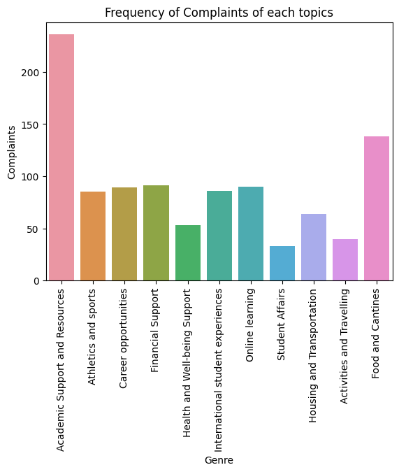
Countplot of each category of Genre
Based on the above graph, we can infer that Most complaints are from Academic Support and Resources and then Food and Cantines.

Slide 8
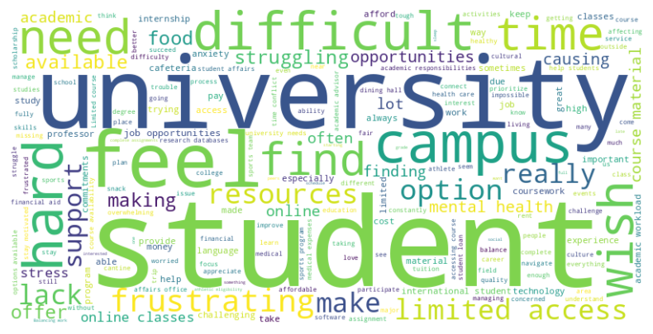
Word cloud
•In our dataset most used words are Student, University, Campus, feel,difficult, hard etc.

Slide 9
NLP Preprocessing Techniques
Reports column contains the students’ complaints
Stop word removal
Lowercasing
Tokenization
Removed number
Lemmatization
Special character and puctuation removal

Slide 10
Text Embedding
TF-IDF Vectorizer
Bag of words

Slide 11
Train Split
The dataset is split into train and test using train test split.

Slide 12
Modelling using ML Algorithms
Multinominal Naïve Bayes
Logistic Regression
Random Forest
Extra Tree Classifier
Stochastic Gradient Descent (SGD)

Slide 13
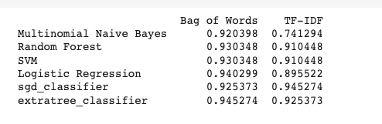
Accuracy Comparison

Slide 14
Hyper tuning
Did hypertuning for Extra tree classifier
There is no increment in accuracy

Slide 15
BERT Model
BERT, which stands for "Bidirectional Encoder Representations from Transformers," is a prominent natural language processing (NLP) model introduced by Google in 2018.
It represents a significant advancement in the field of NLP and has been widely influential in various downstream tasks.
BERT is a deep learning model based on the Transformer architecture, which is pretrained on a large corpus of text data.
This pretrained model has learned to encode contextual information of words in a language, which allows it to understand the meaning of words based on their surrounding context.

Slide 16
Complaint Prioritization
Encoding and Classification: When a new complaint is received, it goes through the same preprocessing steps as during training. The complaint is then fed into the fine-tuned BERT model, which encodes the contextual information of the text. The output from the model is a numerical representation that captures the important features of the complaint.
Prediction: The encoded representation is then used to make predictions about the priority level of the complaint. The model classifies the complaint into different priority categories, such as low, medium, or high, based on the learned associations from the training data.
Prioritization: The predicted priority level is assigned to the complaint, and it is then placed in the appropriate queue or assigned to the relevant administrative staff for further action. High-priority complaints can be addressed with more urgency, while low-priority complaints may be handled in a more routine manner.

Slide 17
Model Deployment
Streamlit
https://complaintspriorityappict.streamlit.app/

Slide 18
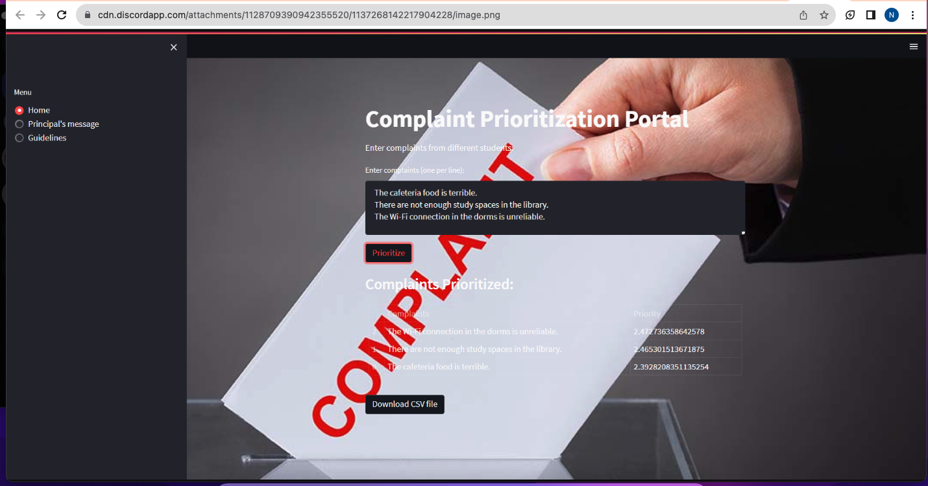
Website Screen shot

Slide 19
Thank You

